Slide 1

OOP
FALL 2019
Lecture : OOP

Slide 2
Why Object Oriented Programming (oop)
Hardware, such as computers and cars, are assembled from parts, which are reusable components.

Slide 3
Why OOP?
Suppose that you want to assemble your own PC, you go to a hardware store and pick up a motherboard.
a processor,
some RAMs,
a hard disk,
a casing,
a power supply,
and put them together.
These component are reusable.

Slide 4
Why OOP?
A car is assembled from parts and components, such as
chassis,
doors,
engine,
wheels,
break,
transmission, etc.
The components are reusable, e.g., a wheel can be used in many cars (of the same specifications).

Slide 5
How about software?
Can you "assemble" a software application by picking a routine here, a routine there, and expect the program to run?
The answer is obviously no
Unlike hardware, it is very difficult t “assemble” an application from software components.

Slide 6
How about software?
The advent of computer 60 years ago, we have written tons and tons of programs.
However, for each new application, we have to re-invent the wheels and write the program from scratch.
Is that correct approach to write each program from scratch??

Slide 7
Traditional Procedural-Oriented languages
Traditional procedural-oriented languages (such as C and Pascal) suffer some notable drawbacks in creating reusable software components:
The programs are made up of functions. Functions are often not reusable. It is very difficult to copy a function from one program and reuse in another program because the the function is likely to reference the headers, global variables and other functions. In other words, functions are not well-encapsulated as a self-contained reusable unit.

Slide 8
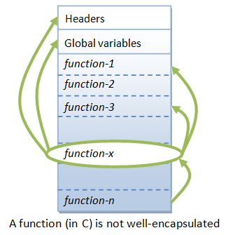
Traditional Procedural-Oriented languages

Slide 9
Object-Oriented Programming Languages
The basic unit of OOP is a class, which encapsulates both the static attributes and dynamic behaviors within a "box", and specifies the public interface for using these boxes.
Since the class is well-encapsulated (compared with the function), it is easier to reuse these classes. In other words, OOP combines the data structures and algorithms of a software entity inside the same box.

Slide 10
Benefits of OOP
Procedural-oriented languages focus on procedures, with function as the basic unit.
Object-Oriented technology has many benefits
Ease in software design as you could think in the problem space rather than the machine's bits and bytes.
Ease in design leads to more productive software development.
Ease in software maintenance

Slide 11
Benefits of OOP
Reusable software: you do not need to keep re-inventing the wheels and re-write the same functions for different situations.
The fastest and safest way of developing a new application is to reuse existing codes - fully tested and proven codes.

